Slide 1
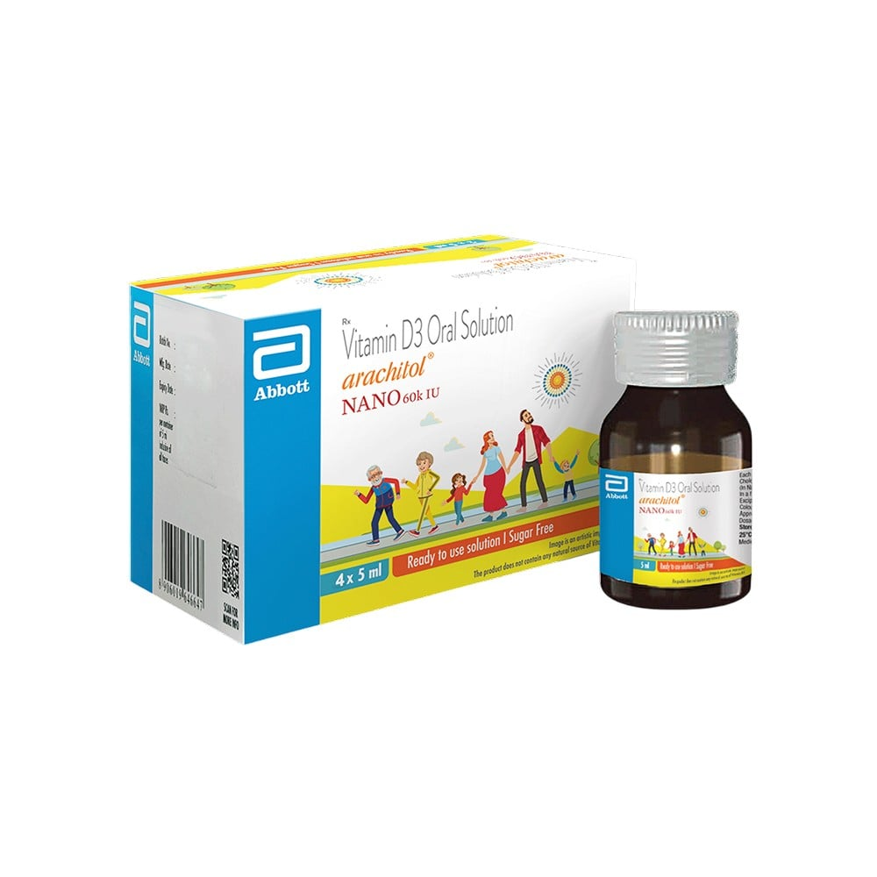
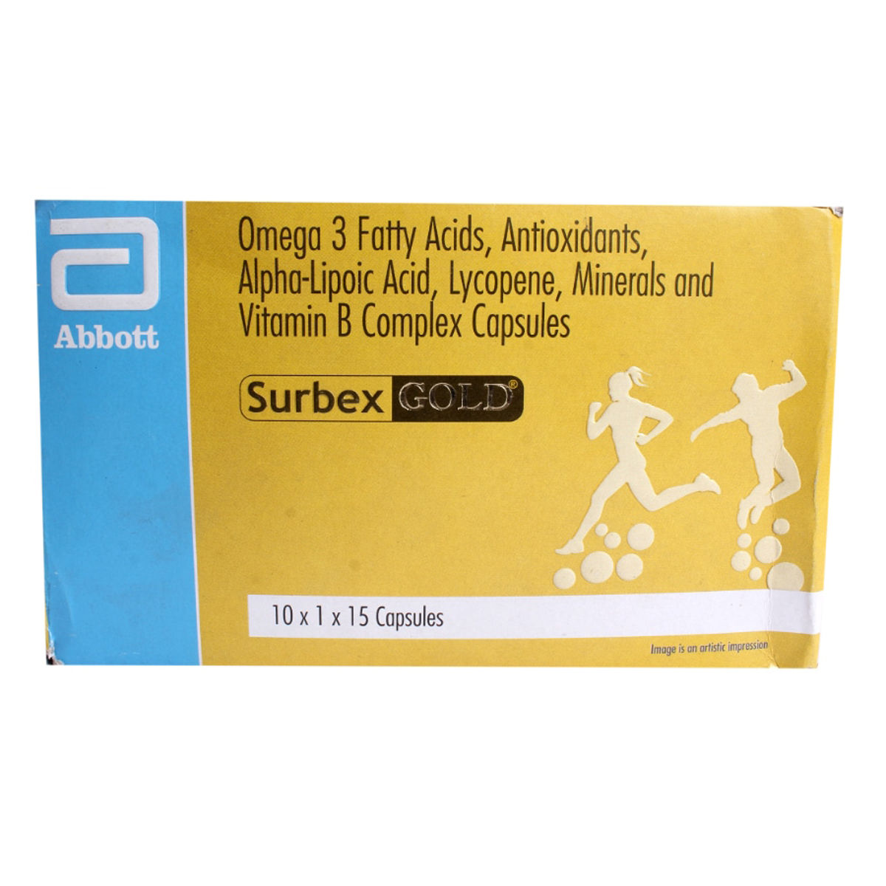
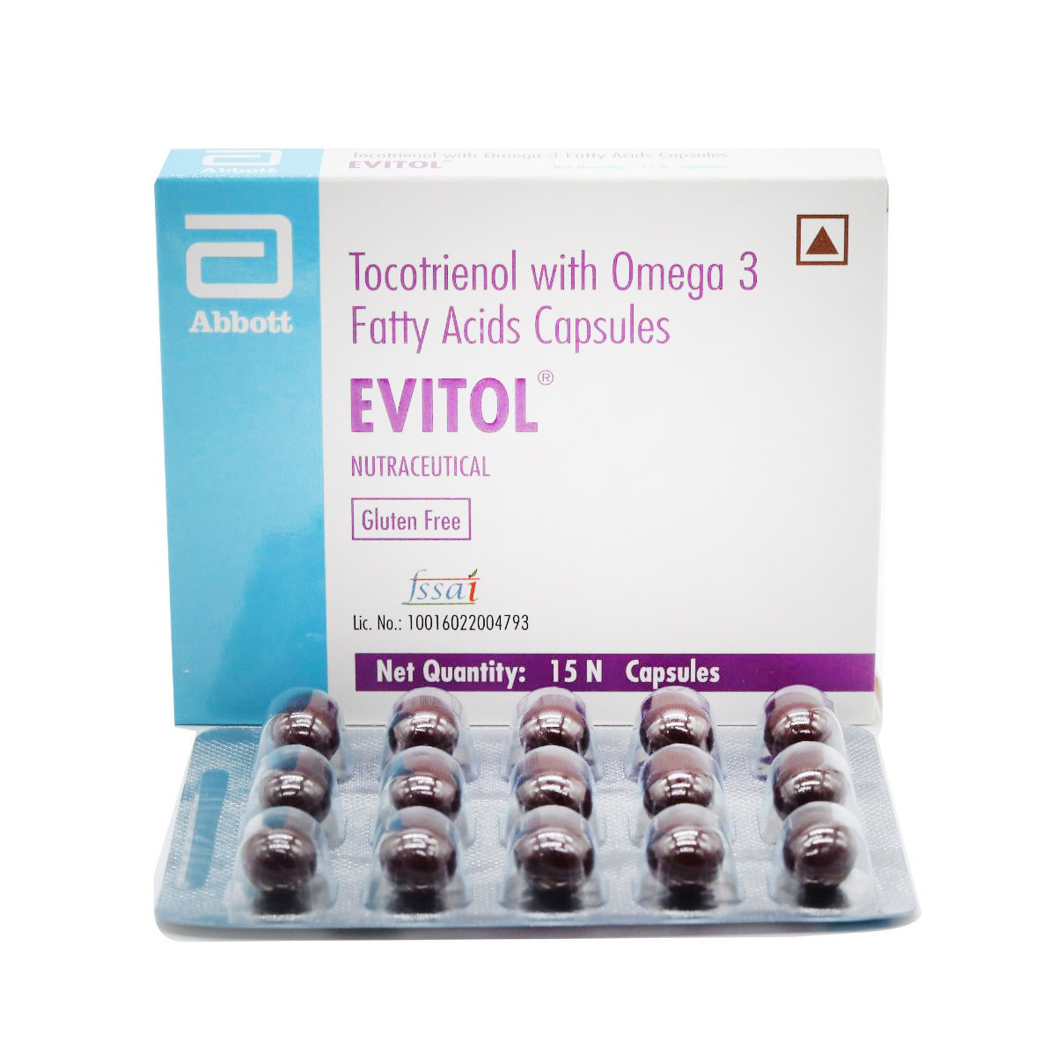
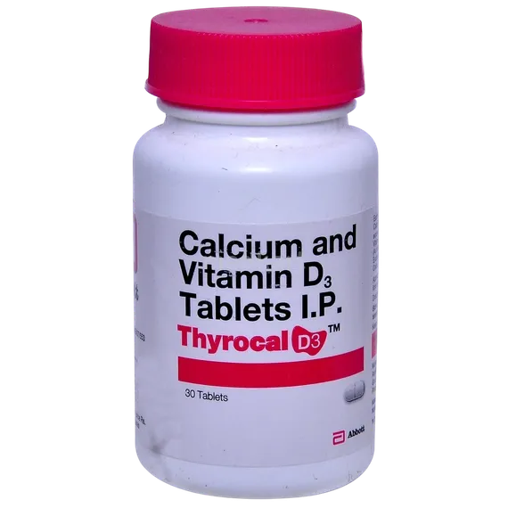
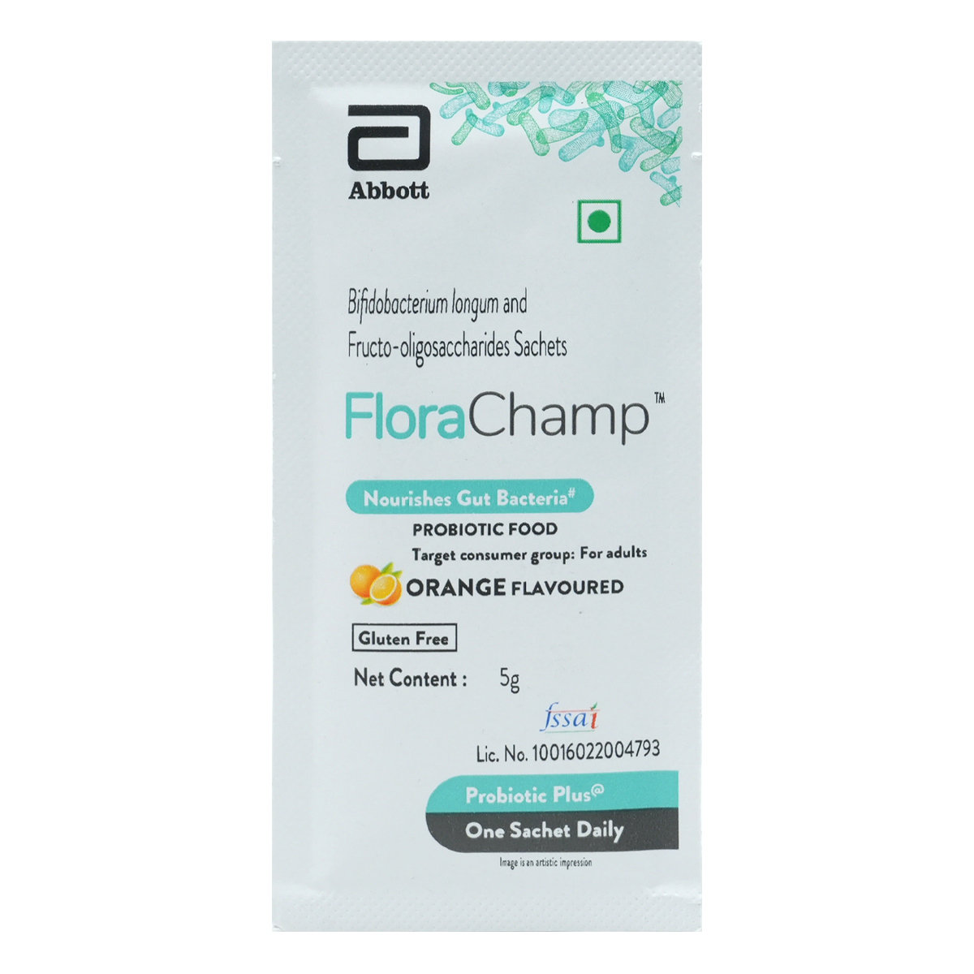
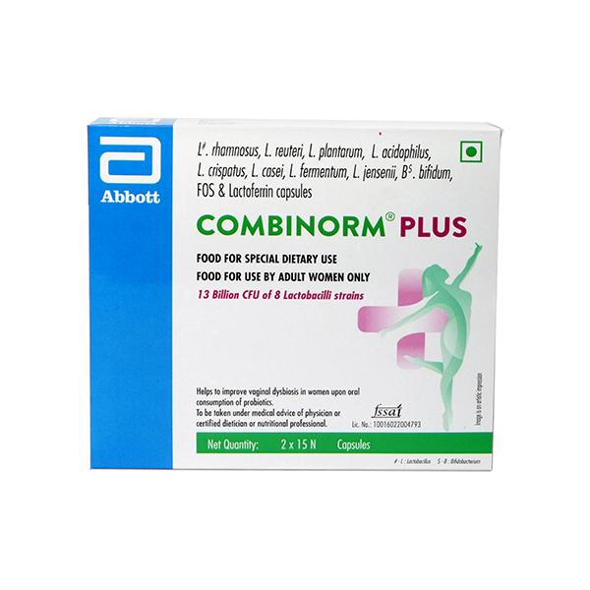
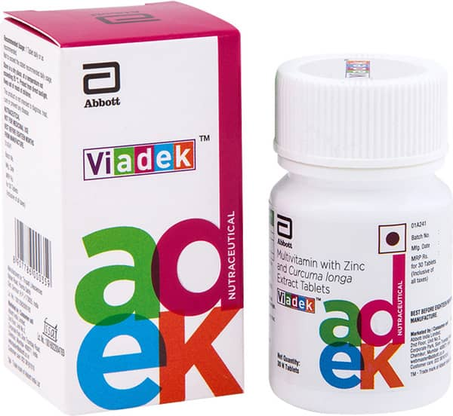
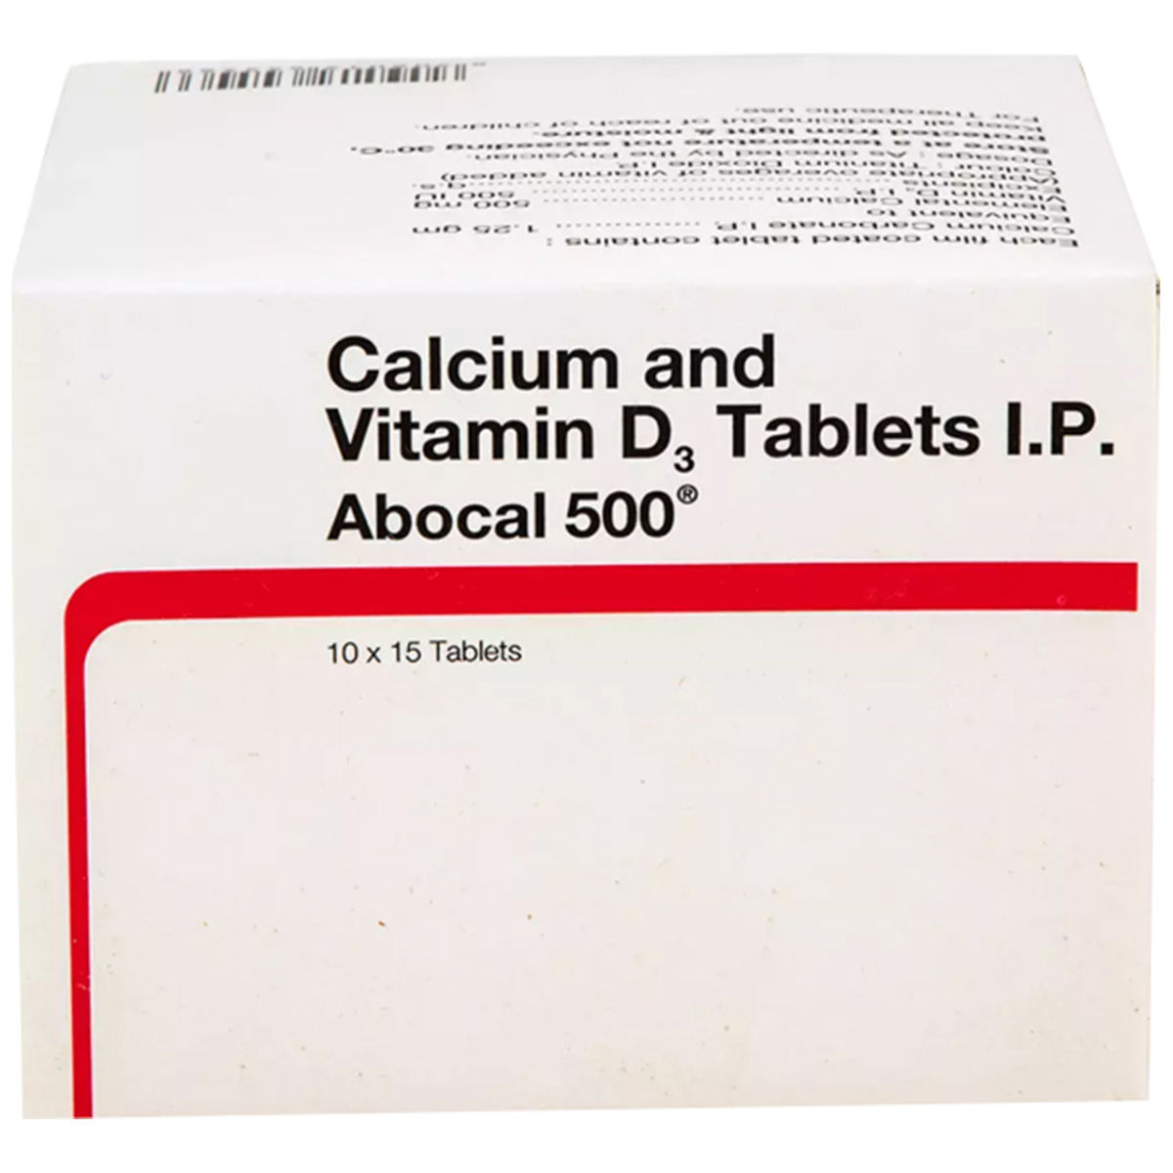
Nutraceutical portfolio: ~5% of Abbott India’s sales may go away
Selected supplements and adjacent products across calcium, vitamins and gut health
Selected brands and product types
Estimated sales exposure
~5%
of listed sales
may go away
Arachitol Nano
Surbex Gold
Evitol
Thyrocal D3
Vitamin D3
Oral solution
Multivitamin formulation
Softgel capsules
Tocotrienol + omega-3
Capsules
Calcium + vitamin D3
Tablets
Also in the portfolio
Benegut
Combinorm
Antoxipan / DS
Citro-Soda / UTI
FloraChamp
Combinorm Plus
Viadek
Abocal
12 brand families
in the supplied screen
Probiotic + prebiotic
Sachets
Probiotics + lactoferrin
Capsules
Multivitamin formulation
Tablets
Calcium + vitamin D3
Tablets
Abbott announced global Nutrition separation on 21 Oct 2026, targeting completion by end-2027.
Source: Abbott India price list, supplied portfolio and product packs. 5% is the supplied estimate. India brand transfers remain unannounced.
Notes:
Revised on 26 October 2026. Product-led exhibit with eight pack shots and the user-requested wording that approximately 5% of listed-company sales may go away. No scenario chart or transfer-scope sensitivity is included.
The 5% figure is the supplied working estimate, not an independently verified company disclosure. The global announcement does not confirm an Abbott India Limited brand transfer or consideration. The caption uses may, and the visible source line preserves the distinction.
Official global announcement dated 21 October 2026: https://www.abbottinvestor.com/static-files/30c3dc25-192e-409e-891b-6c54fc0097de . Global Nutrition approximately USD8.5bn annual sales, targeted separation by end-2027 through a distribution to Abbott Laboratories shareholders. Do not conflate the US parent-shareholder distribution with the Indian listed entity or assert that its brands transfer automatically.
Portfolio and the 12 families are drawn from user IMG_3360.jpg. Eight pictured families: Arachitol, Surbex Gold, Evitol, Thyrocal D3, FloraChamp, Combinorm Plus, Viadek and Abocal. Four additional families shown as text: Benegut, Combinorm, Antoxipan / DS and Citro-Soda / UTI. The groupings and captions describe product types, not a sales ranking.
Primary entity/SKU corroboration: https://www.abbott.in/content/dam/corp/abbott/en-in/homepage/about-abbott/abbott-gst/consumers/Abbott-India-Limited-Price-List.pdf . The products span different HSN categories. Arachitol and Citro-Soda include pharmaceutical as well as food/supplement SKUs. Nutraceutical terminology in the supplied screen does not establish regulatory status or the separation perimeter.
Product photos are illustrative and may show a different pack/strength or older marketer details. Product-type captions follow the pictured labels. No dosage recommendation or therapeutic-benefit claim is made.
Arachitol Nano image: https://cdn.grofers.com/da/cms-assets/cms/product/7922845a-c220-4dad-b8ac-0a42c04e20ff.jpg . Source https://blinkit.com/prn/arachitol-nano-60k-sugar-free-bottle-of-5ml-solution/prid/649566
Surbex Gold image: https://images.apollo247.in/pub/media/catalog/product/S/U/SUR0540_1_1.jpg . Source https://www.apollopharmacy.in/otc/surbex-gold-softgel-capsules-15-s
Evitol image: https://images.apollo247.in/pub/media/catalog/product/E/V/EVI0085_1_1.jpg?tr=q-85 . Source https://www.apollopharmacy.in/otc/evitol-softgel-capsule-15-s
Thyrocal D3 image: https://d1s24u4ln0wd0i.cloudfront.net/med/13392/THYROCAL%20D3%20TABLET%2030%27S_1.webp . Source https://www.medkart.in/order-medicine/thyrocal-d3-tablet-30s
FloraChamp image: https://images.apollo247.in/pub/media/catalog/product/F/L/FLO0579_2.jpg?tr=q-85 . Source https://www.apollopharmacy.in/otc/flora-champ-orange-flav-sachet-5g
Combinorm Plus image: https://cdn.pixelbin.io/v2/plain-cake-860195/netmed/wrkr/products/assets/item/free/original/sYHvcPPl81-combinorm_plus_capsule_2x15s_842052_0_0.jpg . Source https://www.netmeds.com/product/combinorm-plus-capsule-2x15s-mcersm-11276574
Viadek image: https://cdn01.pharmeasy.in/dam/productsnowatermark/H09461/viadek-bottle-of-30-tablets-combo-3-1756954872-non-watermarked.jpg?dim=640x640&q=75 . Source https://pharmeasy.in/online-medicine-order/viadek-tab-30-s-223059
Abocal image: https://images.apollo247.in/pub/media/catalog/product/A/B/ABO0010_1_1.jpg . Source https://www.apollopharmacy.in/otc/abocal-500mg-tablet

